Slide 1
AIPLA – Committee on PCT Issues
Latest PCT Developments at the EPO
Camille Bogliolo
Head of Department, PCT Affairs
Washington, 25 October 2018

Slide 2
US applicants and the EPO as ISA
EPO is Nr. 1: 79,640 ISRs established by the EPO globally in 2017
Notes:
The figures of the global market share (38% in 2016) are based on the established search reports which is the data that was found more relevant by the PCT statistics group than the number of PCT filings selecting the EPO as ISA. The reason lies with the fact that many applications are withdrawn before search and thus this figures shows the actual work performed by ISAs. These are the figures which are monitored since 2012 and reflected by the EPO in all its presentations prepared for PCT Outreach purposes and the PCT flyer distributed in seminars and trade fairs. The PCT statistics group works under the PCT strategy with the participation of representatives from CO, DG1, DG2 and DG5.
The graph is sensitive information that is used only internally. It presents the trend of EPO’s market share in its key markets on the basis of the number of times the EPO was selected as ISA by applicants at the time of filing (WIPO stats):
(1) EPO’s market share in Europe, already high, is even further increasing at 93% in 2016 (to be compared with 92% in 2015 and 91% in 2014)
(2) the EPO is doing very well on all markets in competition with national ISAs, e.g. 70% in Sweden in spite of PRV (63% in 2014), 58% in Finland in spite of PRH (56% in 2014) and 43% in Spain in spite of OEPM (39% in 2014)
(3) the EPO resists very well the competition of new ISAs in the US market with 38% of the market share in 2015 and the position of ISA Nr 1 on this key market (37% in 2015, 35% in 2014) – four of our top 10 PCT applicants as ISA come from the US: Qualcomm Nr 1, Microsoft Nr 4, General Electric Nr 9, Procter & Gamble Nr 10
(4) the EPO has lost market share in Japan with 2% in 2016 (4% in 2014) with Toyota ranking out of our top 10, and in the rest of the World with 4% (6% in 2014).

Slide 3
EPO as ISA: latest news
Improved timeliness: 97% ISRs in time for A1 publication in 2017
PCT Direct service fully operational and available at all ROs
Information on “search strategies”
Prov. Opinion acc. the Partial Search results in cases of non-unity (POPS)
Credit card payment : VISA, MASTERCARD; new Online Payment Portal
Use of ePCT : Filing, SFDs, Demands – getting timely eNotifications

Slide 4
An EPO applicant friendly fee policy (since 1.4.2018)
No inflation-based biennial fee adjustment for 2018-2020
+
PCT fee reduction measures as of 01.04.2018
PCT search
PCT preliminary examination
Examination
European phase
- 5% / - 100 €
- 5% / - 100 €
- 456.25 €
2,095 $
2,334 $
1 875 €
1 775 €
1 930 €
1 830 €
- 50%
- 75%

Slide 5
PCT Collaborative Search and Examination (CS&E)
Framework: IP5 Cooperation Framework 2016; Operational Arrangements 2018
Concept: PCT ISR & WO/ISA from main ISA in collaboration with “peer” ISAs
Aim: high quality search, increased legal certainty early on in the procedure
Duration : 5 Y - preparatory phase (2016-2018); operational phase (2018-2021)
Monitoring: CS&E Pilot Group runs the IP5 project under EPO lead
Status: Operational phase launched on 1 July 2018

Slide 6
Evaluation
CS&E metrics will be monitored over the lifetime of the 500 applications
CS&E - process model
Product
CS&E International Search and Written Opinion
PCT ISA checks CS&E criteria fulfilled, formalities examination, confirms acceptance
Collaborative Search & Examination (CS&E)
Expected Benefits
Earlier information from all IP5 offices
ISA Examiner (Step 1)
Carries out search, prepares provisional opinion and provisional search report
ISA Examiner (Step 2)
Produces final International Search Report and Written Opinion
Applicant driven
All offices contribute to product quality
100 files per ISA over 2 years
“Peer” examiners 4 other IP5 Offices Contribution based on ISA provisional opinion and search report

Slide 7
Scope and quotas to ensure diversity
Complex cases accepted (e.g. non-unity, sequence listings)
Max number of applications per main ISA (100 => 50 per year)
Max number of applications per applicant (10 => 5 per year)
Max number of German and French files (10 => 5 per language)
Max number of applications per technical sector (ICT, MM, HBC)

Slide 8
A user-driven pilot: participation requirements
All details available in EPO Notice (OJ 2018, A47) & Website update
Request to participate must be filed together with PCT application
Participation form and PCT application must be filed in electronic form at the receiving Office (IP5 or IB) – at the EPO: ePCT & OLF
Participation with ISA-EP was open in July only for files in English – closed early Sept. 2018 as the quota (40 files) was exceeded already
Participation will be reopen in July 2019 for files in English

Slide 9
CS&E Pilot – EPO – Status as of 24.10.2018
EPO as main ISA has accepted 41 requests in the Pilot
13 from RO-EP, 20 from RO-US, 7 from RO-IB, 1 from RO-JP
26 final ISR & WO (CS&E mode) have been issued by ISA-EP
EPO as peer ISA has received 31 provisional ISR & WO from IP5 ISAs
19 from ISA-US, 5 from ISA-CN, 4 from ISA-KR and 3 from ISA-JP
20 peer contributions have been issued by EPO as peer ISA

Slide 10
US applicants and the EPO as IPEA
EPO is Nr. 1: 8,370 IPERs established by the EPO in 2017
nearly 3.000
US-based applications selected the EPO as IPEA
in 2017
Notes:
The figures of the global market share (38% in 2016) are based on the established search reports which is the data that was found more relevant by the PCT statistics group than the number of PCT filings selecting the EPO as ISA. The reason lies with the fact that many applications are withdrawn before search and thus this figures shows the actual work performed by ISAs. These are the figures which are monitored since 2012 and reflected by the EPO in all its presentations prepared for PCT Outreach purposes and the PCT flyer distributed in seminars and trade fairs. The PCT statistics group works under the PCT strategy with the participation of representatives from CO, DG1, DG2 and DG5.
The graph is sensitive information that is used only internally. It presents the trend of EPO’s market share in its key markets on the basis of the number of times the EPO was selected as ISA by applicants at the time of filing (WIPO stats):
(1) EPO’s market share in Europe, already high, is even further increasing at 93% in 2016 (to be compared with 92% in 2015 and 91% in 2014)
(2) the EPO is doing very well on all markets in competition with national ISAs, e.g. 70% in Sweden in spite of PRV (63% in 2014), 58% in Finland in spite of PRH (56% in 2014) and 43% in Spain in spite of OEPM (39% in 2014)
(3) the EPO resists very well the competition of new ISAs in the US market with 38% of the market share in 2015 and the position of ISA Nr 1 on this key market (37% in 2015, 35% in 2014) – four of our top 10 PCT applicants as ISA come from the US: Qualcomm Nr 1, Microsoft Nr 4, General Electric Nr 9, Procter & Gamble Nr 10
(4) the EPO has lost market share in Japan with 2% in 2016 (4% in 2014) with Toyota ranking out of our top 10, and in the rest of the World with 4% (6% in 2014).

Slide 11
EPO as IPEA and DO: latest news
top-up search made prior to start Ch2 examination
2nd written opinion always performed with A. 34 PCT amendments
positive IPERs approved by 3-staff examining division
as of 1.7.2019: earlier start for Ch2 examination
solid basis for PPH use with 15 major IP Offices
NEW : Payment of 3rd renewal fee upon entry into Eur. phase
Participation in WIPO-DAS as of 1.11.18 (for EP), next year (for PCT)

Slide 12
Export your invention all over the world
European Patent Office
finds claims patentable
15 Partner offices
expedite prosecution
International Search
with positive written opinion
JP
KR
CN
US
AU
BR
International Preliminary Examination Report
with positive written opinion
Patent Prosecution Highway
CA
CO
EAPO
+ expedited grant
in the European regional phase
IL
MX
MY
European Search
with positive written opinion
PH
RU
SG
Notes:
Under the pilot programme a PPH acceleration request can be made at one of the partner offices based on:
the latest PCT work product (WO-ISA or IPER) established by the EPO, or
an application that has entered the regional phase before the EPO,
provided the EPO has determined one or more claims to be patentable/allowable.
As a matter of principle the basis for a PPH request can be any work product that indicates patentable/allowable claims. In theory this could include also:
positive Supplementary International Search Report
positive Supplementary European Search Report
the decision to grant a European patent.
Currently, however, our operational PPH arrangements make reference to positive ESOP, WO-ISA, or IPER only.
Recent additions:
Russia: February 1st 2017 (OJ 2017, A5).
Malaysia and Philippines: July 1st 2017 (OJ 2017, A46 and A47).
Eurasian Patent Office (EAPO): October 1st 2017 (OJ 2017, A77).
Brazil: Signed on October 5th 2017, entering into force beginning of 2018 for a limited number of applications in specific technical fields.
NOTE: The reverse is also true; i.e. a positive opinion from a PPH partner office can also be used as a basis to request acceleration at the EPO. However, this has no particular advantage over simply filing a request under PACE, which has the same effect without any initial requirements.

Slide 13
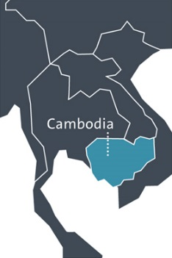
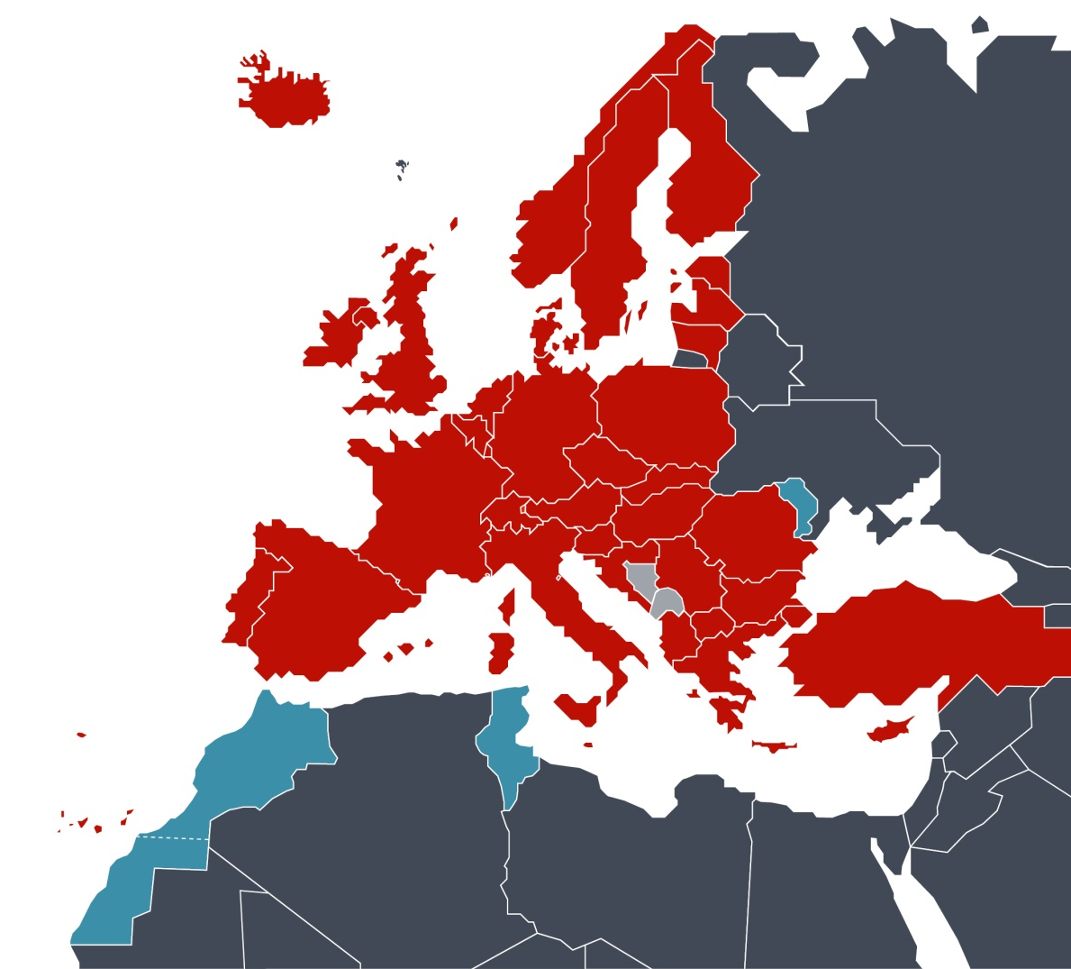
The EPO mission
We provide:
patent protection for inventions
in up to 44 countries
on the basis of one single application
The European Patent Organisation
The Hague
Berlin
Brussels
Munich
Vienna
38 member states
2 extension states
4 validation states
EPO locations

Slide 14
Thank you for your attention!
Further questions at : international_pct_affairs@epo.org

