Slide 2
PCT and International Cooperation Updates from the USPTO
Michael Neas
Deputy Director
International Patent Legal Administration

Slide 3
Overview
Validation software to build the PCT Request form
Drawing corrections
IP5 PCT Collaborative Search & Examination Pilot
Priority Document Exchange
Access to Relevant Prior Art Initiative

Slide 4
Use of validation software to build the PCT Request form
Conventional Request
PCT-Safe
ePCT

Slide 5
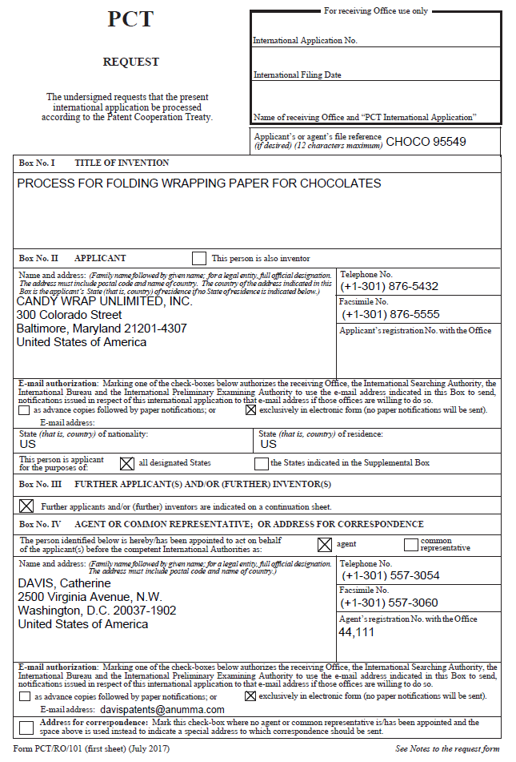
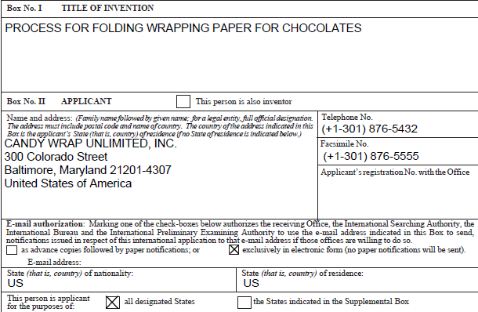
Conventional Request Form - PCT/RO/101

Slide 6
Request Form Prepared with PCT-SAFE Software
The PCT-SAFE software
Available at http://www.wipo.int/pct-safe/en/download/download_client.html
Creates the Request in a validated electronic form
Contains software for electronic filing of IAs in certain ROs
Request prepared using PCT-SAFE
Contains the same information as the PCT/RO/101
But in character coded format (XML)

Slide 7
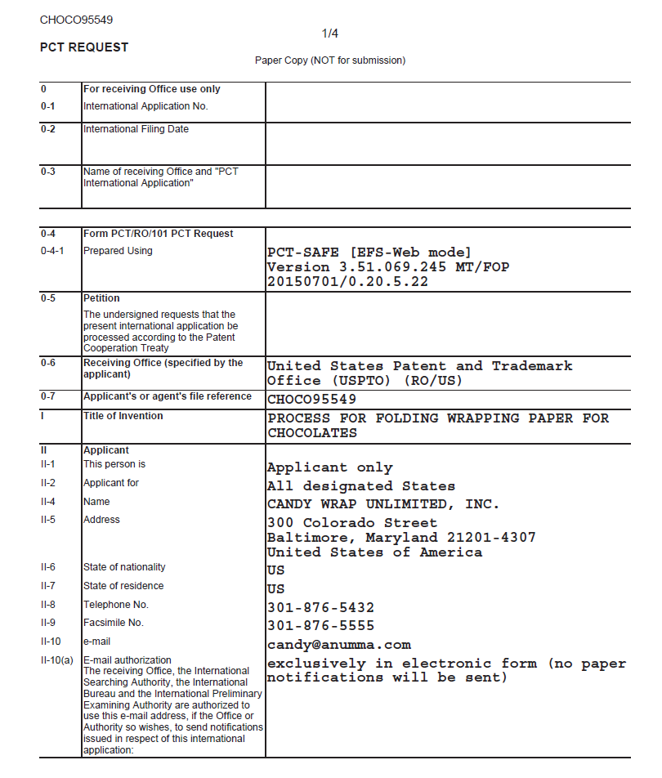
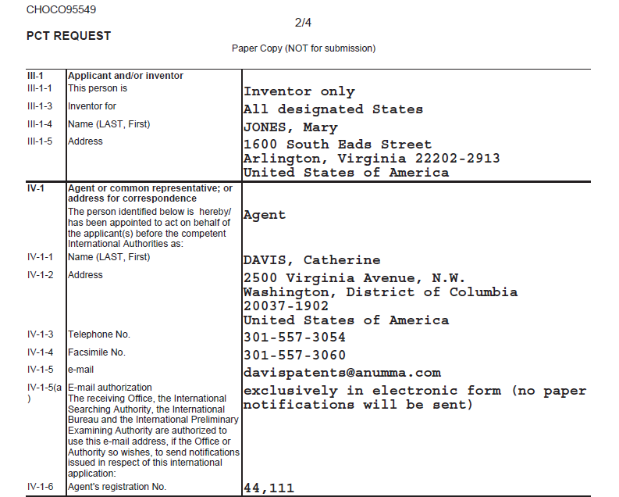
PCT SAFE Request

Slide 8
Request Form Prepared with ePCT
As of 01 June 2016, U.S. applicants are able to use WIPO’s ePCT to create the Request in validated electronic form
Contains the same information as the PCT/RO/101
In character-coded format (XML)
Caveat
A foreign filing license does not authorize the export of subject matter into ePCT (i.e. the title and, optionally, the abstract) when the international application is to be filed with the RO/US
See the Federal Register Notice for the full details https://www.gpo.gov/fdsys/pkg/FR-2016-05-06/pdf/2016-10733.pdf

Slide 9
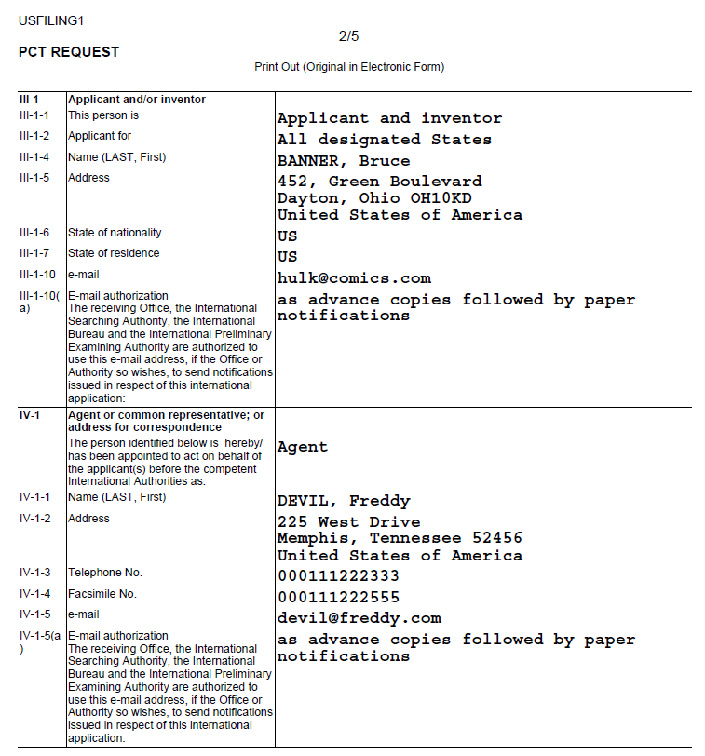
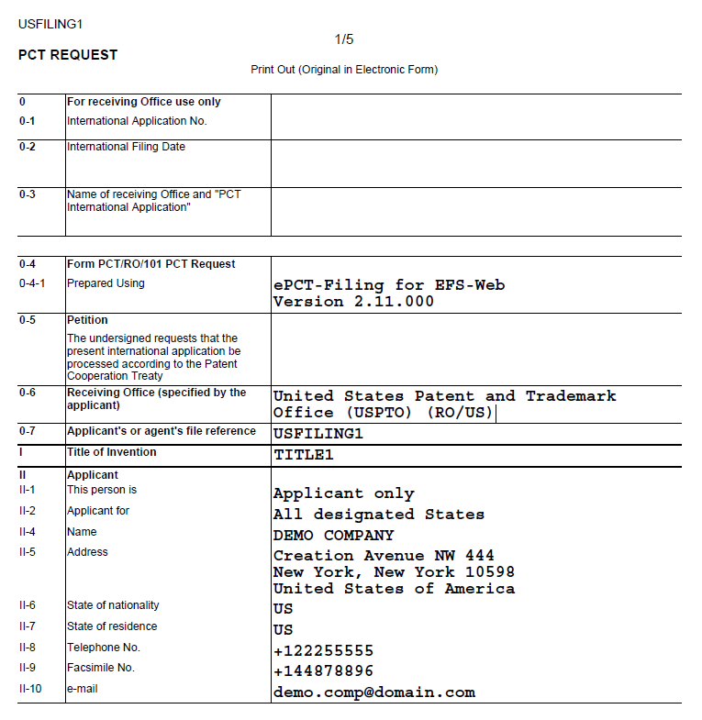
ePCT Request

Slide 10
Request Form Prepared with PCT-SAFE or ePCT
When filing the international application electronically via EFS-Web
The .ZIP file created using PCT-SAFE or ePCT is to be attached
EFS-Web will extract the Request and Fee sheet from the .ZIP file
PDF of the abstract must be separately uploaded since the EFS-Web does not extract the abstract from the .ZIP file

Slide 11
Reduction of International Filing Fee – International Application Filed Electronically
$103 Reduction applies where
The international application is filed electronically via EFS-Web without the PCT-SAFE or ePCT .ZIP file
Be sure to attach the .PDF version of the Request (form PCT/RO/101)
$205 Reduction applies where
The international application is filed electronically via EFS-Web with the PCT-SAFE or ePCT .ZIP file attached
Be sure to attach the .PDF version of the abstract

Slide 12
Who is using PCT-Safe or ePCT in RO/US?
International applications filed in RO/US with a zip file
2014 – 55%
2016 – 39%
2018 – 40%

Slide 13
Formal drawings
Providing drawings compliant with Rule 11 on filing avoids hassles later
Invitation from RO to correct (Form PCT/RO/106)
Correction may require approval from ISA under Rule 91
No amendment to drawings in Chapter I
May need to wait for Chapter II or national phase in order to amend
Prevents national/regional Offices from requiring new drawings based on form
PCT Art. 27 – No national law shall require compliance with requirements relating to the form or contents of the international application different or in addition to those which are provided for in this Treaty and the Regulations.

Slide 14
IP5 PCT CS&E Pilot
IP5 pilot project aimed at testing the feasibility of collaborative work between examiners of different offices in the international phase of the PCT
Third stage of pilot between EPO, KIPO, SIPO, JPO and USPTO (IP5)
First 2 stages included KR, EP and US
Communications between examiners will take place via a collaboration tool (ePCT) being arranged by WIPO
Commencement date – July 1, 2018

Slide 15
IP5 PCT CS&E Pilot
PCT Collaboration Pilot Procedure, in general:
A first office (selected ISA) will prepare a provisional ISR, WOISA and search strategy
Provisional reports will be presented to peer examiners in other 4 offices
Peer offices will comment on or complement this provisional work
The complement may be a focused search on particular aspects or a full search
KR developed peer review form
First office will issue a final ISR and WO-ISA after considering the peer examiners’ contributions

Slide 16
IP5 PCT CS&E Pilot
Applicant Driven
Must request participation when filing PCT
Number of applications per applicant will be limited
Number of applications
100 as main ISA
400 as peer

Slide 17
IP5 PCT CS&E Process Model

Slide 18
IP5 PCT CS&E Pilot
Final work product will be identified as a collaborative effort
Applications will be in English
Other languages may be added after first 6 months
Examination in US – Hybrid
Contractors will do main search
OPQA
Will function as peer examiners
Will review input from other offices.

Slide 19
IP5 PCT CS&E Pilot – Stats (As of 17 October 2018)
61 applications filed with RO/US accepted into pilot.
31 for ISA/US
20 ISA/EP
1 ISA/JP
9 ISA/KR
EPO has filled its quota of English applications.
Total applications accepted by ISAs
JP – 3
CN – 28
KR - 18
US - 32

Slide 20
Priority Document Exchange (PDX)
Expanded scope of participation in WIPO’s Digital Access Service (DAS)
Accessing and providing Office for industrial designs from 01 October 2018
Migration from bilateral exchange to exchange via WIPO DAS
USPTO – JPO, 01 Oct, 2017
USPTO – CNIPA, 01 Sept, 2018

Slide 21
Access to Relevant Prior Art Initiative
Objectives
Leveraging electronic resources to retrieve information (e.g., prior art, search reports, etc.) from relevant sources (e.g., related U.S. applications, counterpart foreign and PCT applications).
Automatically import information into the file wrapper of a U.S. patent application under examination at the earliest point.
Potentially reduce applicant’s burden under the duty of disclosure.

Slide 22
Outreach Efforts To Date
External:
Focus sessions at regional offices in June 2016
Federal Register Notice – August 2016
Public Roundtable – September 28, 2016
Written Comments – October 28, 2016
PPAC Presentation – November 2017
Ongoing Various Speaking Events
Internal:
Examiner Focus Sessions – April 2017
Expanded Examiner Focus Sessions – June 2017
Examiner Survey – September 2017
User Center Design Council Sessions – November, December 2017

Slide 23
Project Research
Evaluation of Data Sources
Global Dossier, Common Citation Document, PatentScope, USPTO Internal IT Systems, etc.
Application Case Studies
400+ cases reviewed to consider effects of importing prior art on prosecution and on examiners

Slide 24
Access to Relevant Prior Art: Phase 1
Automatically imports references from immediate U.S. parent applications into pending U.S. applications
New automated tool for examiners developed to provide a master reference list and enhanced searching and filtering functionality

Slide 25
Access to Relevant Prior Art: Phase 1
Develop a user interface in examiner’s tools
Ability to view a master reference list, including references cited in the instant application (by applicant and examiner) and imported references from immediate U.S. parent applications (cited by applicant and examiner, but not third parties)
Enhanced functionality including:
Filtering the reference list
Creating a search string of U.S. patent documents that could be imported into existing or new search tools
Functionality developed to provide notice to the applicant
Imported references
References considered by the examiner

Slide 26
Access to Relevant Prior Art: Phase 1
Initial implementation will be a targeted release and will not be a corps-wide release
Details and scope of the implementation will be were announced later today
Subsequent phases of the project will focus on importing from additional sources, such as counterpart foreign and PCT applications

Slide 27
FY 2018/2019 Next Steps
Further engagement of external stakeholders – 2018/2019
Federal Register Notice – TODAY!
Gathering and Refining Business Requirements – Ongoing
Phase 1 Business Solution Initial Release – November 2018

Slide 28
Access to Relevant Prior Art Contacts
E-mail: PriorArtAccess@USPTO.gov
Michael Neas
Deputy Director, International Patent Legal Administration
571-272-3289
Michael.Neas@USPTO.gov
Jessica Patterson
Director, International Outreach and Administration
571-272-8828
Jessica.Patterson@USPTO.gov

Slide 29
Questions?
Michael Neas
Deputy Director, International Patent Legal Administration
Michael.Neas@uspto.gov
PCT Help Desk
(571) 272-4300
Monday – Friday 8:30am – 5:00pm ET

