Slide 1
The view from WIPO: PCT update and certain best practices
AIPLA PCT Issues Committee
25 October 2018

Slide 2
Quick PCT Status

Slide 3
Key Moments in PCT History
June 1, 1978: commencement of PCT filings
18 Member States
5 International Authorities
10 PCT staff at the International Bureau of WIPO

Slide 4
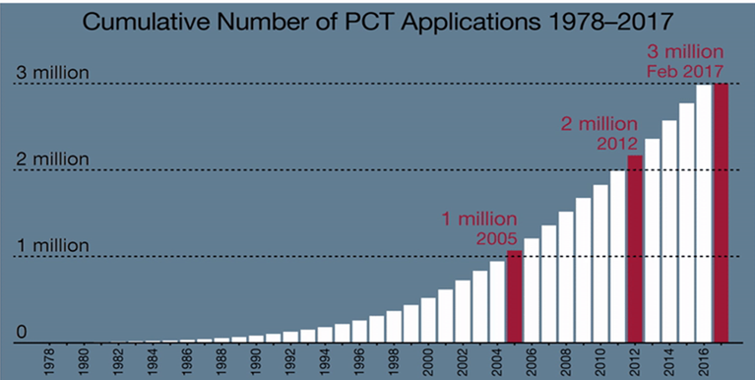
Key Moments in PCT History
26 years to 1st million
7 years to 2nd million
5 years to 3rd million

Slide 5
PCT Applications
2017: 243,500 (+4.5%)

Slide 6
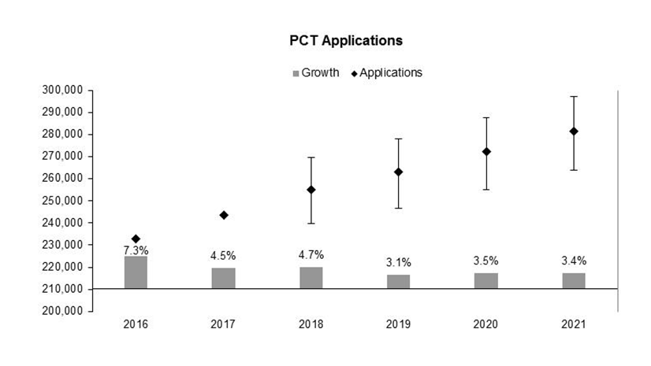
PCT Application Filings--projected
Source: Economics and Statistics Division, WIPO

Slide 7
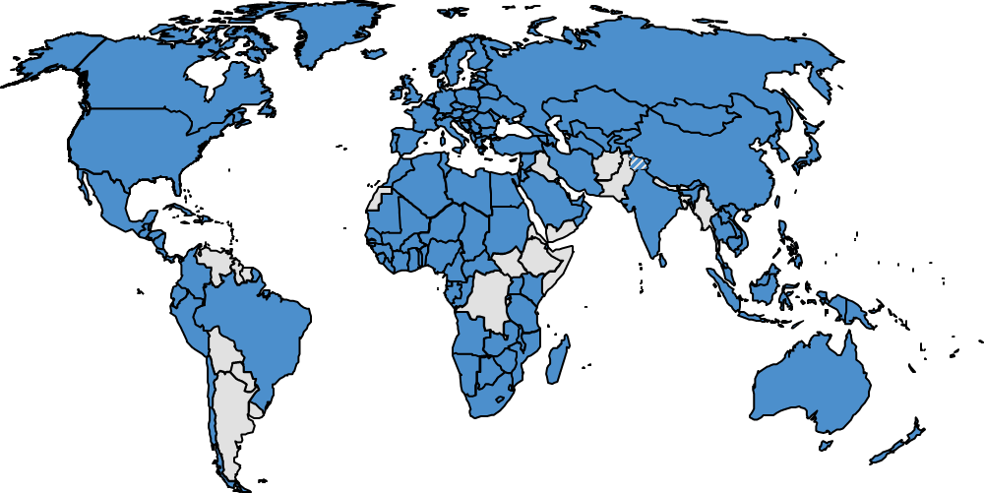
PCT Coverage Today

Slide 8
152 PCT States
=PCT
Albania
Algeria
Angola
Antigua and Barbuda
Armenia
Australia
Austria
Azerbaijan
Bahrain
Barbados
Belarus
Belgium
Belize
Benin
Bosnia and Herzegovina
Botswana
Brazil
Brunei Darussalam
Bulgaria
Burkina Faso
Cambodia
Cameroon
Canada
Central African Republic
Chad
Chile
China
Colombia
Comoros
Congo
Costa Rica
Côte d'Ivoire
Croatia
Cuba
Cyprus
Czech Republic
Democratic People's
Republic of Korea
Denmark
Djibouti
Dominica
Dominican Republic
Ecuador
Egypt
El Salvador
Equatorial Guinea
Estonia
Finland
France,
Gabon
Gambia
Georgia
Germany
Ghana
Greece
Grenada
Guatemala
Guinea
Malawi
Malaysia
Mali
Malta
Mauritania
Mexico
Monaco
Mongolia
Montenegro
Morocco
Mozambique
Namibia
Netherlands
New Zealand
Nicaragua
Niger
Nigeria
Norway
Oman
Panama
Papua New Guinea
Peru
Philippines
Guinea-Bissau
Honduras
Hungary
Iceland
India
Indonesia
Iran (Islamic Republic of)
Ireland
Israel
Italy
Japan
Jordan
Kazakhstan
Kenya
Kuwait
Kyrgyzstan
Lao People’s Dem Rep.
Latvia
Lesotho
Liberia
Libyan Arab Jamahiriya
Liechtenstein
Lithuania
Luxembourg
Madagascar
Poland
Portugal
Qatar
Republic of Korea
Republic of Moldova
Romania
Rwanda
Russian Federation
Saint Lucia
Saint Vincent and the Grenadines
San Marino
Sao Tomé e Principe
Saudi Arabia
Senegal
Serbia
Seychelles
Sierra Leone
Singapore
Slovakia
Slovenia
South Africa
Spain
Sri Lanka
Sudan
Swaziland
St. Kitts and Nevis
Sweden
Switzerland
Syrian Arab Republic
Tajikistan
Thailand
The former Yugoslav
Republic of Macedonia
Togo
Trinidad and Tobago
Tunisia
Turkey
Turkmenistan
Uganda
Ukraine
United Arab Emirates
United Kingdom
United Republic of Tanzania
United States of America
Uzbekistan
Viet Nam
Zambia
Zimbabwe
Notes:
8

Slide 9
UN Member States not yet in PCT
Afghanistan
Andorra
Argentina
Bahamas
Bangladesh
Bhutan
Bolivia
Burundi
Cape Verde
Democratic Republic of Congo
Eritrea
Ethiopia
Fiji
Guyana
Haiti
Iraq
Jamaica
Kiribati
Lebanon
Maldives
Marshall Islands
Mauritius
Micronesia
Myanmar
Nauru
Nepal
Pakistan
Palau
Paraguay
Samoa
Solomon Islands
Somalia
South Sudan
Suriname
Timor-Leste
Tonga
Tuvalu
Uruguay
Vanuatu
Venezuela
Yemen
(41)

Slide 10
International applications received in 2017 by country of origin
CN: +13.4% (double digit growth every year since 2003)
SE: +7%
JP: +6.6%
Asia: 49.1%
Europe: 24.9%
North America: 24.3%
23.3% originating in US, 20% in China, 19.8% in Japan
63% from the top 3 countries, 77% from top 5 countries, 93% of filings from top 15 countries

Slide 11
PCT International Searching Authorities
The appointed ISAs/IPEAs are the following 23 offices:
Australia
Austria
Brazil
Canada
Chile
China
Egypt
European Patent Office
Finland
India
Israel
Japan
Nordic Patent Institute
Philippines
Republic of Korea
Russian Federation
Singapore
Spain
Sweden
Turkey
Ukraine
United States of America
Visegrad Patent Institute

Slide 12
Additional key numbers for 2017
243,500 PCT applications filed by 52,355 applicants from 126 PCT Contracting States in 85 receiving Offices, 96.2% being filed electronically
31.2% of the PCT applications filed in 2017 contained female inventors
231,400 ISRs issued by 22 ISAs, 84.1% within 3 months of the receipt of the search copy by the ISA
Top 5 ISAs: EPO (34.4%), JPO (19.9%), SIPO (19.1%), KIPO (10.9%), USPTO (9.1%)) established 93.4% of ISRs
223,600 PCT applications published by WIPO, 77.9% within 1 week of 18 month time limit
47.6% English, 19.4% Japanese, 15.7% Chinese, 7.4% German, 5.8% Korean, 2.7% French, 0.7% Spanish, 0.4% Russian, 0.2% Portuguese, 0.1% Arabic
615,400 PCT national phase entries (2016) representing 56.2% of worldwide non-resident filings

Slide 13
More info on PCT 2017
PCT Yearly Review: http://www.wipo.int/edocs/pubdocs/en/wipo_pub_901_2018.pdf

Slide 14
PCT WG 2018 Outcomes
Agreed amendment to Rule 69.1(a), allowing IPEA to begin IPE when in possession of demand, fees, ISR and WO (effectively reversing current default, unless applicant requests postponement)
IB to draft new amendment proposals for 2019 WG on “erroneously filed elements and parts”
IB to consult member States on issues relating to proposed fee reduction for universities and prepare document for 2019 WG on options and implementation issues
IB invited to work with Offices and users on requirements and proposals for systems to assist national phase entry
Noted:
IB-proposed priorities and directions for future development of PCT
document on PCT applications linked to UN Security Council sanctions, and concluded that IB’s existing arrangements for handling such cases are appropriate and fully consistent with PCT

Slide 15
PCT Priority Areas (1)
Quality of international work products (paramount to PCT’s role as work sharing tool for Offices)
Collaborative search pilot {EPO/USPTO will discuss}
Develop quality metrics
Increase feedback from designated Offices to ISAs
Making PCT accessible to applicants from all Contracting States
Potential further fee reductions
Help DOs more easily access and better understand & utilize reports
PATENTSCOPE, WIPO CASE, Global Dossier
Training of DO examiners in use of PCT reports

Slide 16
PCT Priority Areas (2)
Optimize PCT data and financial flows to maximize efficiency
Centralized, user-friendly payment facilities
“Netting structure”
Improve the technical environment and level of technical cooperation between Offices
ePCT and beyond (GIPP)
real-time, secure access by all to up-to-date, accurate data throughout international phase and into national phase
promote XML filing and processing
improved machine translation
develop IT systems/standards to support sharing information with other Offices more effectively

Slide 17
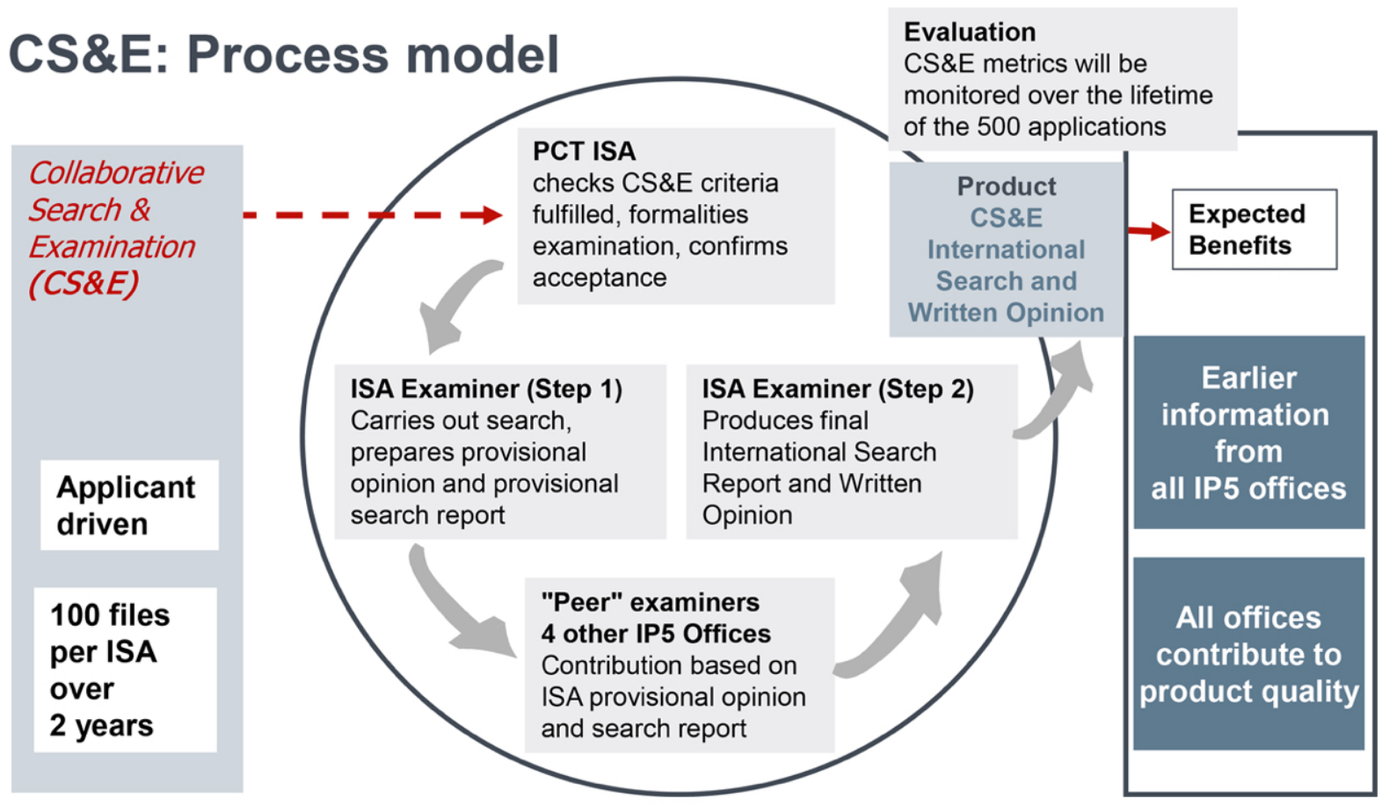
Collaborative search and examination: IP5 Pilot
measure effects and benefits in national phase
results to be reported to PCT/WG, for possible integration into PCT at later stage
ePCT to serve as CS&E platform for IP5 Offices

Slide 18
WIPO Global IP Platform
Single common Global IP Platform which consolidates the customer experience when accessing all WIPO services
revenue management and data assets capture and management across the business lines and associated ICT systems
To enable customers with little prior knowledge of IP to better access WIPO’s services and easily manage fee payments:
universities, SMEs and individual businesses
particularly in developing countries
[3 minute overview video]

Slide 19
PCT Best Practices

Slide 20
Filing-related
State-of-the-art docketing system in place, and all measures that a “reasonably prudent agent” would put in place
second pair of eyes review, etc.
can be critical in being able to establish “due care” in the contexts of reestablishment of rights (Rule 49.6) and in restoration of priority (Rule 26bis.3)—see, e.g, PCT Receiving Office Guidelines paragraphs 166J to 166M
When e-filing:
(and before pressing “Send”!), double-check that the correct files have been attached
Check for possible conversion errors
Submit pre-converted files if accepted by RO—see AI Section 706
RO/US does not accept

Slide 21
After Filing
Once filed, review what you have filed, ideally on the date of submission, through ePCT
If a mistake as been made:
correction may be possible
Incorporation by reference (though not a perfect solution in all cases because of diverging office practices)
Monitor receipt of Forms PCT/RO/105 and PCT/IB/301
Priority documents
Best: ask RO to prepare and transmit in request form
If not possible, use DAS
depositing and accessing offices (for national/regional applications):
AU, BR, DK, CL, CN, EAPO, EE, ES, FI, GB, IB, IN, JP, KR, MA, NL, NZ, SE, US
If not possible: order paper document

Slide 22
International Publication
Where possible, verify correctness and completeness of publication on date of publication on PatentScope
If there are errors in the publication not present in what you filed, contact the IB immediately
ePCT can generate a “pre-copy” of the to-be published application to verify correctness
agents can usefully have the client verify data in this “pre-copy”

Slide 23
Specific procedures (1)
Withdrawals:
Always/only file with IB, virtually never with RO
Exception: withdrawal before record copy has been transmitted to IB: file with RO
use “ePCT action” or at least ePCT upload of Form PCT/IB/372
Safeguard: Use conditional language if anywhere near international publication
Signature: All applicant signatures are required
Submit without signatures to meet time limit?
will not work for 30-month time limit
will, however, at least postpone publication

Slide 24
Specific procedures (2)
Restoration of priority:
Do it before RO or DO?
Consider submitting any restoration of priority requests to RO/IB
Solid explanation required for due care
If you trying to meet the “unintentional” standard, for example, with RO/IB, please don’t tell us anything other than “I intended to file within the time limit”
Recording of changes (92bis)
92bis requests should always and only be filed with IB
Submit request without signatures and/or proof or evidence to meet the time limit
Check any Form PCT/IB/306 received for correctness

Slide 25
National phase-related
Use ePCT to provide local agent with access to relevant documents
National phase entry time limit
applies irrespective of possible delays during international phase
Where national phase entry time limit has been missed, use Rule 49.6:
Does Rule 49.6 apply?
If yes, which criterion is applicable?
Which time limit applies?
10 “high value targets” (CA, CN, DE, IN, KR, LV, MX, NZ, PH, PL) still don’t explicitly apply 49.6 but a number of them have provisions under the national law providing for something like reinstatement
there may be some other offices which don’t fully understand their obligation to apply it
Please contact IB if you encounter national phase situations which you believe are not in line with what the PCT provides

