Slide 1

The Patent Cooperation Treaty (PCT)
End of the year 2019 Update
Webinar
Matthias Reischle, Deputy Director, PCT Legal Division, WIPO

Slide 2
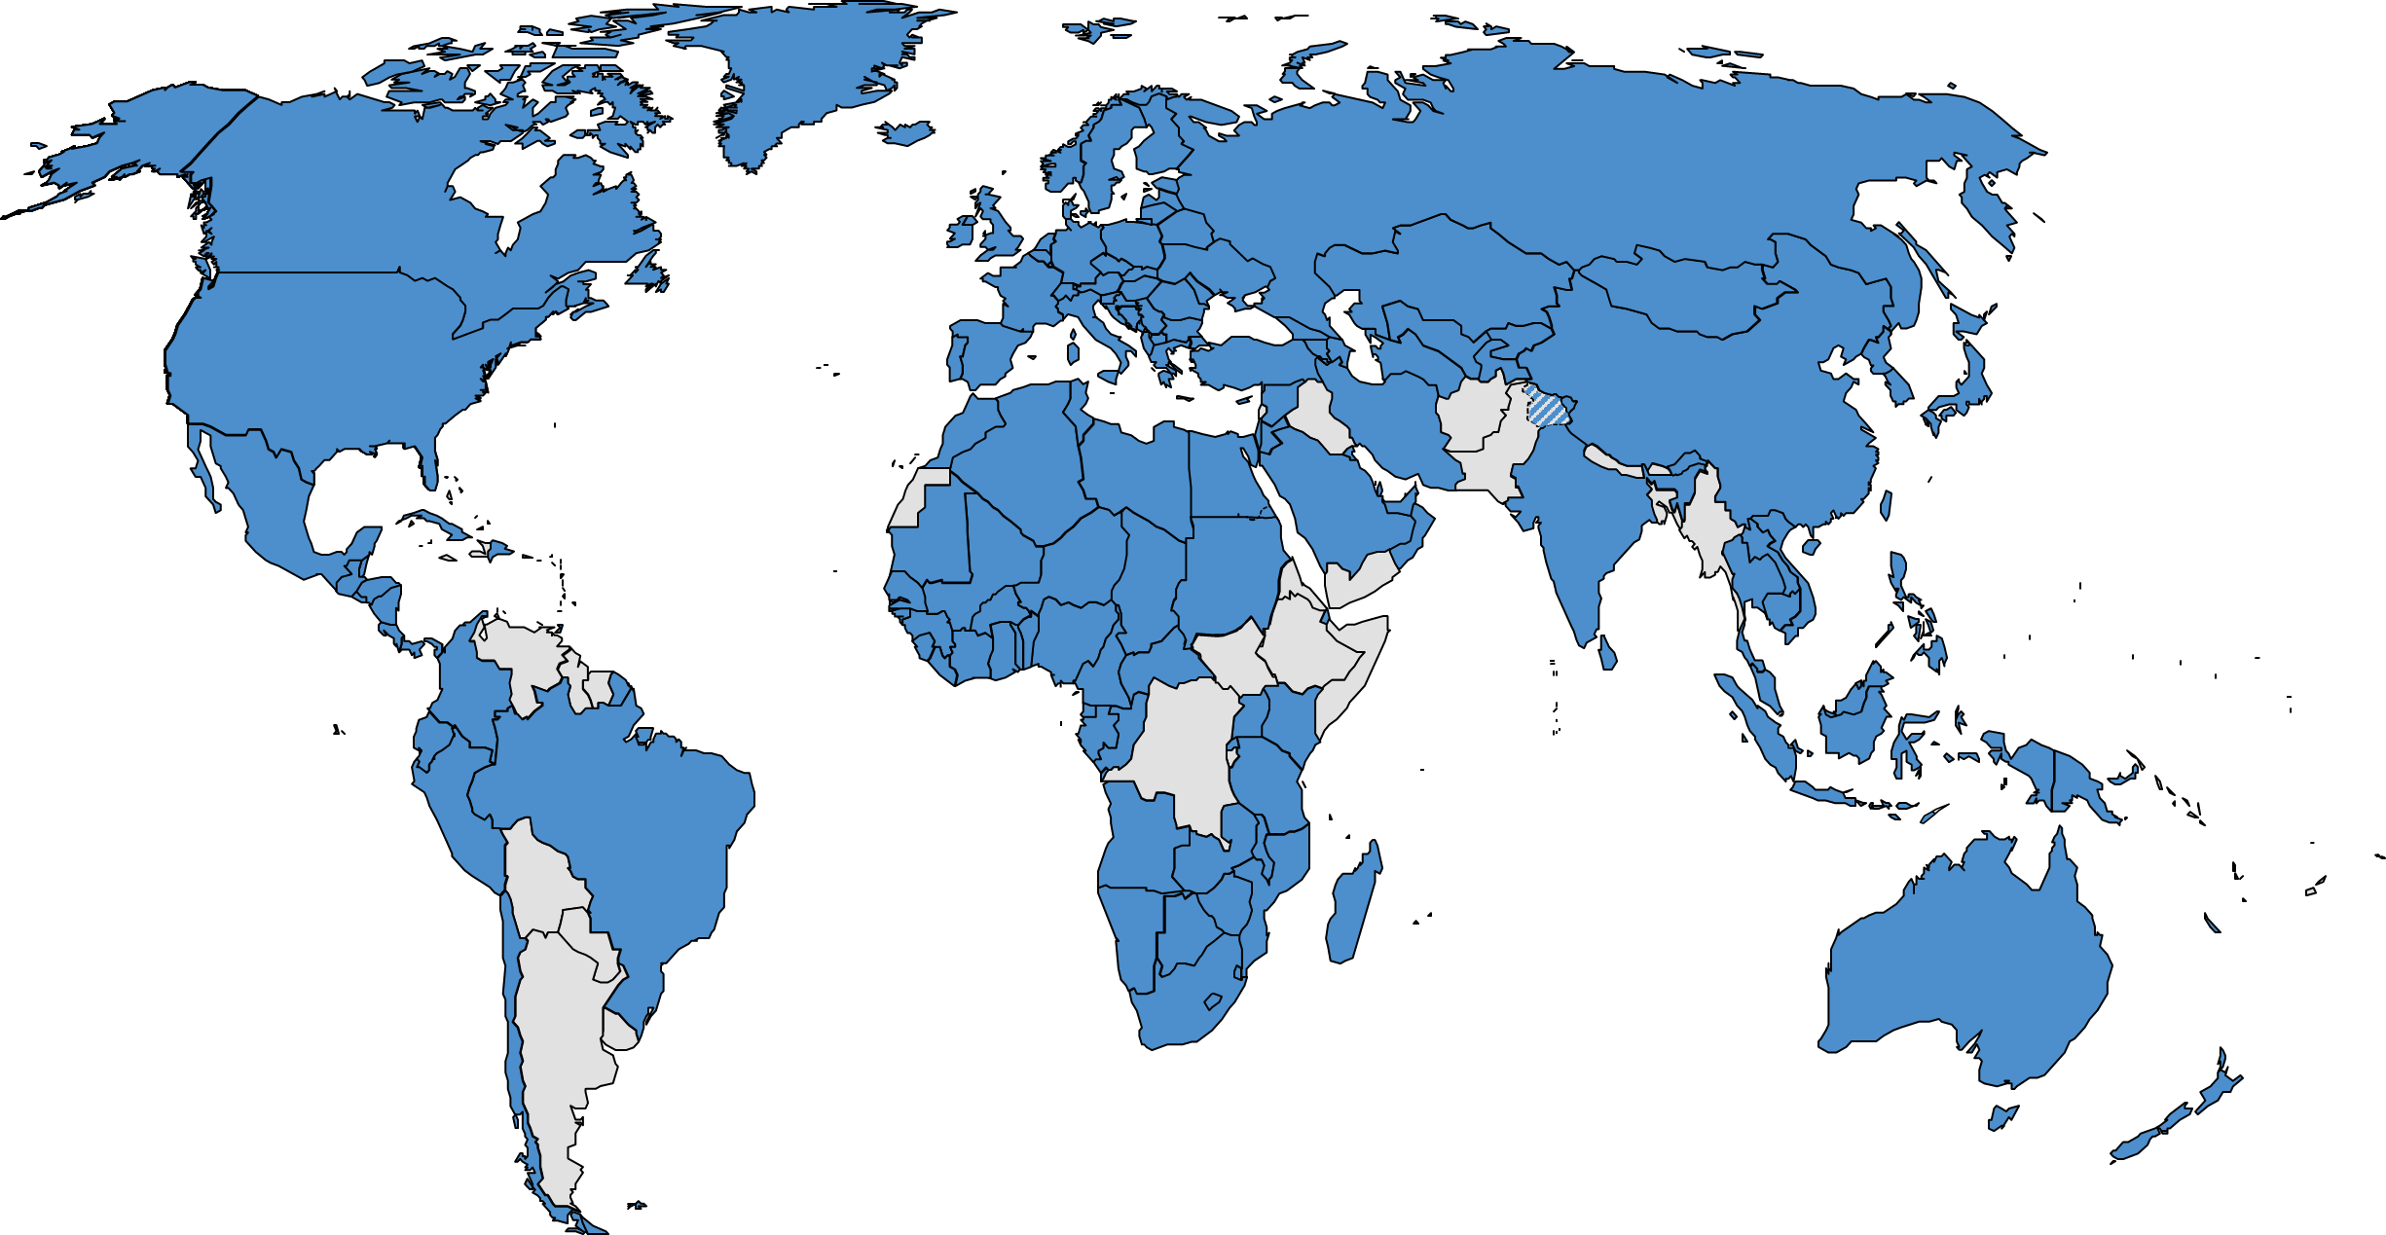

153 PCT States
=PCT
Albania
Algeria
Angola
Antigua and Barbuda
Armenia
Australia
Austria
Azerbaijan
Bahrain
Barbados
Belarus
Belgium
Belize
Benin
Bosnia and Herzegovina
Botswana
Brazil
Brunei Darussalam
Bulgaria
Burkina Faso
Cambodia
Cameroon
Canada
Central African Republic
Chad
Chile
China
Colombia
Comoros
Congo
Costa Rica
Côte d'Ivoire
Croatia
Cuba
Cyprus
Czech Republic
Democratic People's
Republic of Korea
Denmark
Djibouti
Dominica
Dominican Republic
Ecuador
Egypt
El Salvador
Equatorial Guinea
Estonia
Finland
France,
Gabon
Gambia
Georgia
Germany
Ghana
Greece
Grenada
Guatemala
Guinea
Malawi
Malaysia
Mali
Malta
Mauritania
Mexico
Monaco
Mongolia
Montenegro
Morocco
Mozambique
Namibia
Netherlands
New Zealand
Nicaragua
Niger
Nigeria
Norway
Oman
Panama
Papua New Guinea
Peru
Philippines
Guinea-Bissau
Honduras
Hungary
Iceland
India
Indonesia
Iran (Islamic Republic of)
Ireland
Israel
Italy
Japan
Jordan
Kazakhstan
Kenya
Kuwait
Kyrgyzstan
Lao People’s Dem Rep.
Latvia
Lesotho
Liberia
Libya
Liechtenstein
Lithuania
Luxembourg
Madagascar
Poland
Portugal
Qatar
Republic of Korea
Republic of Moldova
Romania
Rwanda
Russian Federation
Saint Lucia
Saint Vincent and
the Grenadines
Samoa (Jan 2, 2020)
San Marino
Sao Tomé e Principe
Saudi Arabia
Senegal
Serbia
Seychelles
Sierra Leone
Singapore
Slovakia
Slovenia
South Africa
Spain
Sri Lanka
Sudan
Swaziland
St. Kitts and Nevis
Sweden
Switzerland
Syrian Arab Republic
Tajikistan
Thailand
The former Yugoslav
Republic of Macedonia
Togo
Trinidad and Tobago
Tunisia
Turkey
Turkmenistan
Uganda
Ukraine
United Arab Emirates
United Kingdom
  United Republic of Tanzania
  United States of America
Uzbekistan
Viet Nam
Zambia
Zimbabwe

Slide 3
Countries not yet PCT Contracting States
(40)
Afghanistan
Andorra
Argentina
Bahamas
Bangladesh
Bhutan
Bolivia
Burundi
Cabo Verde
Democratic Republic of Congo
Eritrea
Ethiopia
Fiji
Guyana
Haiti
Iraq
Jamaica
Kiribati
Lebanon
Maldives
Marshall Islands
Mauritius
Micronesia
Myanmar
Nauru
Nepal
Pakistan
Palau
Paraguay
Solomon Islands
Somalia
South Sudan
Suriname
Timor-Leste
Tonga
Tuvalu
Uruguay
Vanuatu
Venezuela
Yemen

Slide 4
Tremendous growth in PCT applications since 1978
2018: +3.9%

Slide 5
International applications received in 2018 by country of origin
CN: +9.1%
KR: +8%
IN: + 27.2%
FI: +14.7%
Asia: 50.5%
Europe: 24.5%
North America: 23.1%
22.1% originating in US, 21% in China, 19.6% in Japan
62.7% from the top 3 countries, 77.5% from top 5 countries, 92.4% of filings from top 15 countries

Slide 6
PCT applications by region - 2008 and 2018

Slide 7
Top PCT Applicants in 2018
Huawei Technologies—CN (5,405)
Mitsubishi Electric—JP (2,812)
Intel—US (2,499)
Qualcomm—US (2,404)
ZTE—CN (2,080)
Samsung—KR (1,997)
BOE Technology Group—CN (1,813)
LG Electronics—KR (1,697)
Ericsson—SE (1,645)
Bosch—DE (1,524)
Microsoft—US (1,476)
Panasonic—JP (1,465)
Sony—JP (1,342)
Siemens—DE (1,211)
Hewlett-Packard—US (1,170)
() of published
PCT applications

Slide 8
PCT Rule Changes as from 1 July 2019
Amendment to PCT Rule 69.1(a)
    Allows the IPEA to start the international preliminary examination when:
      it is in possession of the demand, relevant fees, ISR and written opinion;
      unless the applicant expressly requests the IPEA to postpone the start of the examination until expiration of the time limit for filing a Chapter II demand (Rule 54bis.1(a)) (as opposed to starting examination only once that time limit has expired)
    Effective for demands made on or after July 1, 2019

Slide 9
Rule changes adopted by PCT Assembly in October 2019
  PCT Assembly adopted the following amendments to the Regulations:
  In the case of erroneously filed elements and parts in an international application, provisions to incorporate by reference the correct elements or parts
Provision of a legal basis for the transfer via the IB of fees collected by one Office for the benefit of another Office
Requirement for the IPEA to copy certain documents from its file to the IB, which the IB would make available to the public on behalf of the elected Office
Provision of a legal basis for an Office to excuse delays in meeting a time limit due to the unavailability of any permitted electronic means of communication at that Office, such as unforeseen outages or scheduled maintenance

Slide 10
Rule changes adopted by the PCT Assembly in October 2019 (cont.)
Provision of a legal basis for the correction or addition of indications in the request provided for in Rule 4.11 during the international phase
  Applicants will be able to submit a notice to the IB, within 16 months from the priority date, to correct or add an indication of the wish that the application be treated, in a designated State, as an application for:
    a patent of addition, certificate of addition, inventor’s certificate of addition or utility certificate of addition; or
    a continuation or a continuation‑in‑part of an earlier application

Slide 11
PCT WG 2019
Not agreed:
  proposed fee reduction for universities
  proposal to give all PCT applicants choice of all ISAs
    Further work will be done on these two proposals
Noted Progress reports on:
  IP5 Collaborative Search and Examination Pilot
  Netting of PCT fees
  PCT sequence listing standard
  PCT online services
  PCT Minimum Documentation

Slide 12
Color drawings (1)
Applications containing color or greyscale content
  Not permitted in PCT applications (Rule 11)
  Since applications often contain color or greyscale content, the IB has included some features in ePCT and PCT-SAFE
    ePCT-Filing will automatically detect color or greyscale content and warn the applicant that the application content should be in black and white
    PCT-SAFE allows applicants to indicate (checkbox) that the application contains color or greyscale content (only for filings with RO/IB)
  A dedicated preview function has been made available by the IB in order to allow applicants to view the application content as it will be rendered by the IB
    Directly available in ePCT-Filing
    https://pctdemo.wipo.int/DocConverter/pages/pdfValidator.xhtml

Slide 13
Color drawings (2)
Publication of applications containing color or greyscale content
  The application will be converted into black and white format for further processing and publication by the IB
  If the application contained color or greyscale content, the front page of the published PCT application will contain a notice to that effect
  Any original color or greyscale content will be made available on PATENTSCOPE as part of the public application file
Attention:
  Designated Offices are not obliged to take the color or greyscale content into account, and may rely on the PCT application as published in black and white

Slide 14
Best means of communication with the IB (1)
For the filing of new applications with RO/IB:
  Applicants should use ePCT (recommended) or PCT-SAFE;
  In the event that neither service is available, international applications can also be uploaded through the new “Contingency Upload Service” (see https://pct.wipo.int/ePCTExternal/pages/UploadDocument.xhtml)

Slide 15
Best means of communication with the IB (2)
For the submission of post-filing documents to the IB and RO/IB:
  Applicants should use ePCT (recommended);
  In the event that ePCT is not available, applicants can use the new “Contingency Upload Service”
To receive Forms and communications from the IB in urgent cases:
  Access your application file through ePCT (strong authentication) (recommended)
  Authorize the IB to send forms and communications to you by e-mail (ideally “by e-mail only”)
  As of January 1, 2020, urgent communications will no longer be sent by fax

Slide 16
Best means of communication with the IB (3)
The IB strongly discourages the use of fax as a means of communication with the IB for the following reasons:
  Technical unreliability of fax transmissions
  Transmission failures and/or legibility issues are always the applicant’s responsibility (Rule 92.4(c))
  Positive fax transmittal report on the applicant’s side does not prove successful transmission
As from January 1, 2020, the IB will nevertheless continue to operate a limited fax service as an additional safeguard for applicants who experience technical difficulties in submitting documents electronically
  The only remaining two PCT fax numbers can be found on the PCT resources website (https://www.wipo.int/pct/en/)
  Applicants are advised to contact the “authorized officer” in relation to the application before sending a fax during regular business hours at the IB (or otherwise leave a message on an answering device)

Slide 17
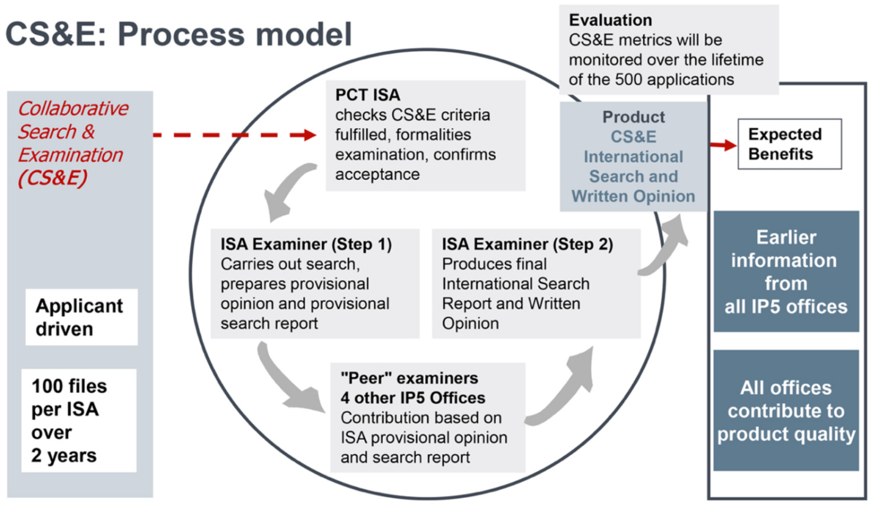
Collaborative Search and Examination
Explore collaborative search and examination: IP5 Pilot
  measure effects and benefits in national phase
  results to be reported to PCT/WG, for possible integration into PCT at later stage
  ePCT to serve as CS&E platform for IP5 Offices

Slide 18
WIPO IP Portal
Single common portal launched September 17 which consolidates the customer experience when accessing all WIPO services, databases and tools
  unified navigation
  single sign-on
  modernized look and feel
  customizable interface which you will see when you login with your WIPO Account
  streamlined payments—will be able to view and process payments for Hague, PCT and Madrid, and PayPal being added
  gradual introduction of centralized messaging system
  https://www.wipo.int/portal/en/news/2019/article_0029.html
  PCT “widgets” included, in addition to integrated ePCT access:
    “key PCT time limits”
    “ePCT pending items”
    More to come

Slide 19
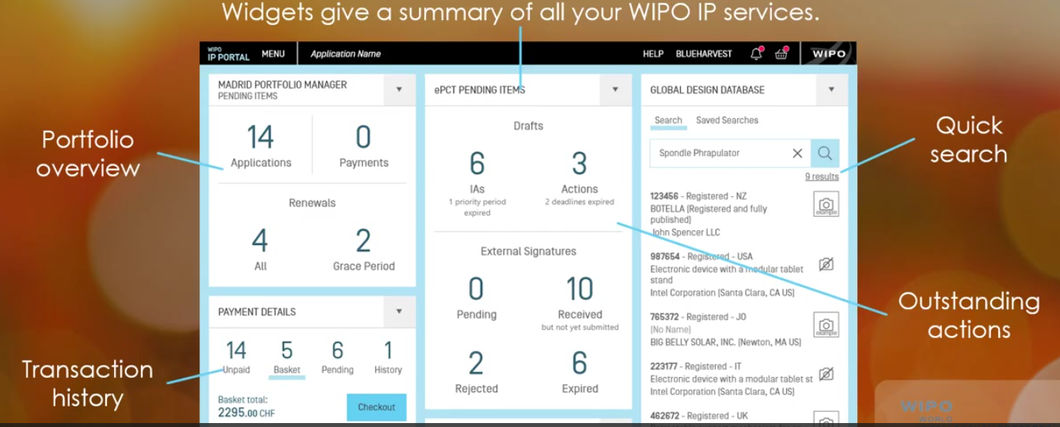
IP Portal
https://www.wipo.int/portal/en/news/2019/article_0033.html (News: Portal)
https://pct.wipo.int (ePCT via Portal)
https://ipportal.wipo.int/ (WIPO IP Portal)

Slide 20
Additional PCT Issues
Work continues on quality of PCT work-products with ISAs/IPEAs in the Quality Subgroup of the MIA
IB continues to try to optimize data and financial flows in the PCT
  the proposed amendments to the Regulations on transfer of fees will permit, when Offices are ready, centralized payment of all PCT fees to the IB which will notify and transmit to the corresponding offices
We continue investing in ePCT and the PCT technical environment
Working on revising PCT pages on WIPO website to make PCT information resources for users easier to find
PCT user survey coming in next months—we would greatly appreciate your feedback and thank you in advance

Slide 21
PCT Information and Training
29 video segments on WIPO’s Youtube channel and WIPO’s PCT page about individual PCT topics
PCT Distance learning course content available in the 10 PCT publication languages, and a 2nd detailed PCT DL course under preparation
PCT Webinars
  free updates on developments in PCT procedures, and PCT strategies—previous webinars are archived and freely available
  upon request also for companies or law firms, for example, for focused training on how to use ePCT
Videoconference and audio possibilities also available
In-person PCT Seminars and training sessions: see PCT seminar calendar (http://www.wipo.int/pct/en/seminar/seminar.pdf)
Monthly Newsletter (http://www.wipo.int/pct/en/newslett/)
Extensive information resources on PCT website (http://www.wipo.int/pct/en/)
If you’d like to discuss PCT training, contact us

Slide 22
PCT Contacts
For general questions about the PCT, contact the PCT Information Service at:
      Telephone: (+41-22) 338 83 38
      E-mail: pct.infoline@wipo.int
Contact the speaker:
matthias.reischle@wipo.int
+41-22-338-9627

